Slide 1
Image Generation using Artificial Intelligence
Submitted in the partial fulfillment for the award of the degree of
BACHELOR OF ENGINEERING
IN
Information Security
Submitted by:
Prakash Singh
20BCS3707
Under the Supervision of:
Shiwani Sharma
Department of AIT-CSE
DISCOVER . LEARN . EMPOWER

Slide 2
Outline
Introduction to Project
Problem Formulation
Objectives of the work
Methodology used
Results and Outputs
Conclusion
Future Scope
References

Slide 3

Introduction to Project
Artificial intelligence (AI) is a rapidly advancing field that aims to develop machines and computer programs that can perform tasks that would normally require human intelligence. Art and Design industry has always been an expensive and time-consuming field which require lot of resources and skilled creative people to create interactive interfaces, logo, NFTs, posters and product design. Small time businesses and individuals can’t afford the kind of prices and time required for this. Image generation using artificial intelligence make all these with no cost and time. It uses deep learning model like GAN and VAE to generate realistic images

Slide 4
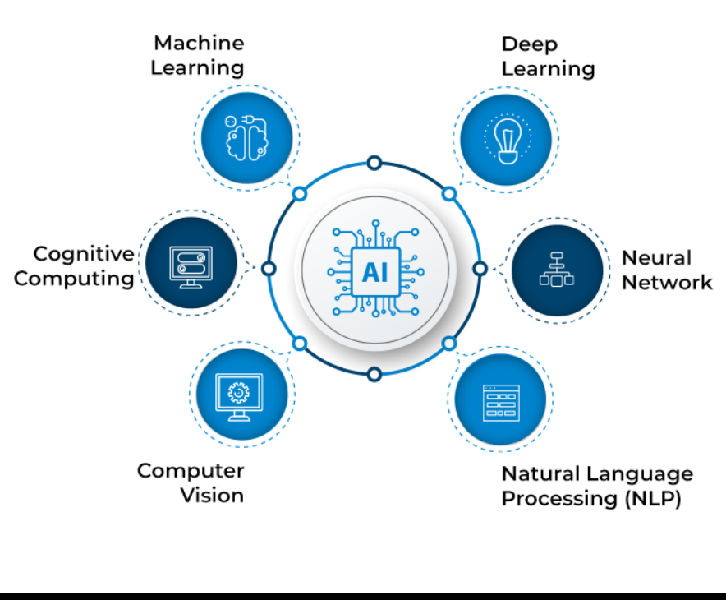
Key component of artificial intelligence

Slide 5
Art and Design industry has always been an expensive and time-consuming field which require lot of resources and skilled creative people to create interactive interfaces, logo, NFTs, posters and product design. Small time businesses and individuals can’t afford the kind of prices and time required for this.
Image generation using artificial intelligence make all these with no cost and time. It uses deep learning model like GAN and VAE to generate realistic images of faces, landscapes, and even entire cities, and have a wide range of applications in fields such as art, design, and entertainment.

Slide 6
Problem Formulation
Image generation is an expensive and time-consuming field which require lot of resources and skilled creative people to create interactive interfaces, logo, NFTs, posters and product design. Small time businesses and individuals can’t afford the kind of prices and time required for this.
the objective of image generation using artificial intelligence is to leverage the power of machines to enhance human creativity, productivity, and problem-solving abilities. This helps in cost-effective production, time saving ,improving realism and augmenting human abilities.

Slide 7
Objectives of the Work
the objective of image generation using artificial intelligence is to leverage the power of machines to enhance human creativity, productivity, and problem-solving abilities.
Enhancing creativity: AI can generate images that are beyond the human imagination, enabling artists and designers to explore new possibilities and push the boundaries of creativity.
Cost-effective production: AI-generated images can significantly reduce the cost of production.
Timesaving: AI-generated images can save time by automating the design process, allowing designers to focus on other aspects of the project.
Improving realism: AI can generate images that are incredibly realistic, making them useful in fields such as virtual reality, simulation, and gaming.
Augmenting human abilities: AI-generated images can help humans in various fields, such as medical diagnosis, scientific research, and engineering design.

Slide 8

Methodology used
Detailed study of the work done in the field of image generation using AI
Relative pros and cons will be identified.
Various parameter will be identified to evaluate the proposed system.
A deep learning model will be chosen based on the desired output.
The development Environment will be set up.
Developing a frontend for the web application using react
Using the API of the deep learning model for creating images
Connecting database with frontend using API or middleware
generate new images on the basis of user input
Comparison of new implemented approach with exiting approach will be done.

Slide 9
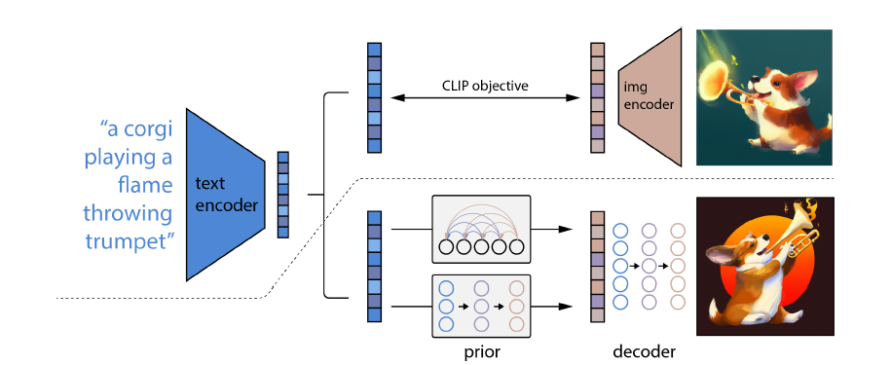
Working Of Deep Learning Model: DALL-E

Slide 10



The Frontend development was done using reactjs, npm and tailwindcss to make it faster and reliable in loading and decreases the size of our decentralised web application
MongoDB was used as a document database used to build highly available and scalable internet applications
Cloudinary provides cloud-based image and video management services. It enables us to upload, store, manage and deliver images for our web application.

Slide 11



Our Middleware was developed using NodeJS that is used for connecting backend to front end and DALL-E API
ExpressJS was used to make connections along with NodeJS
DALL-E API was used for generating stunning high quality images from text given by the user

Slide 12
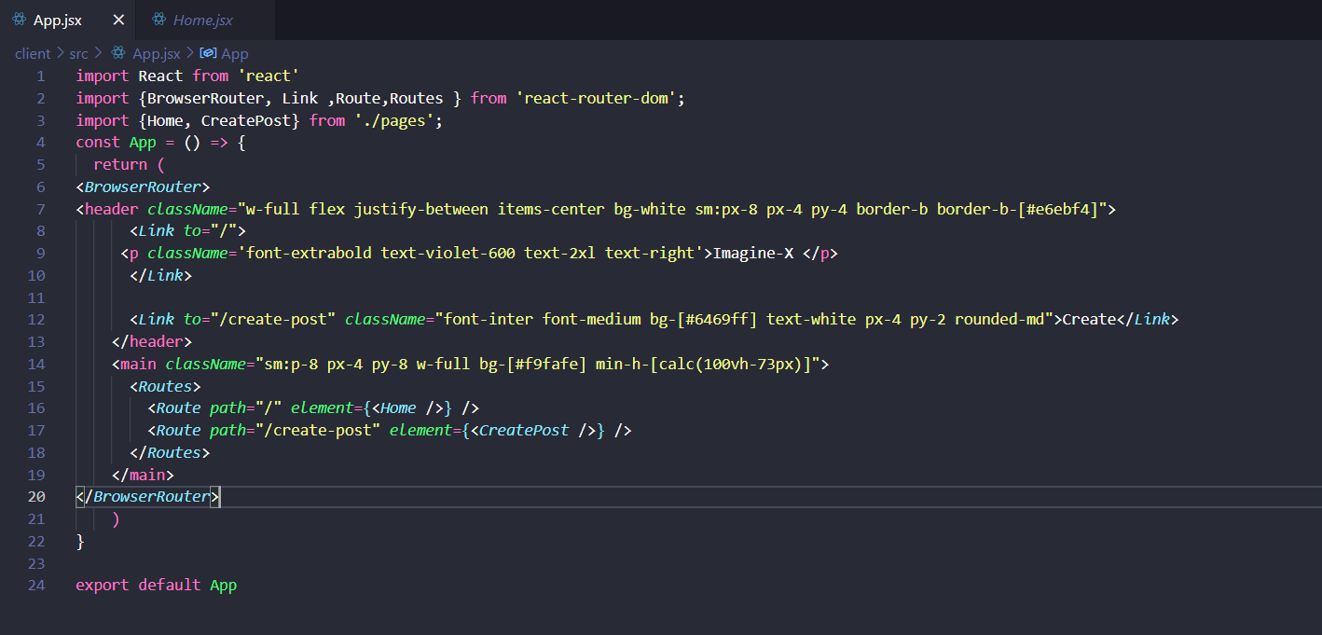
header
Result and Output

Slide 13

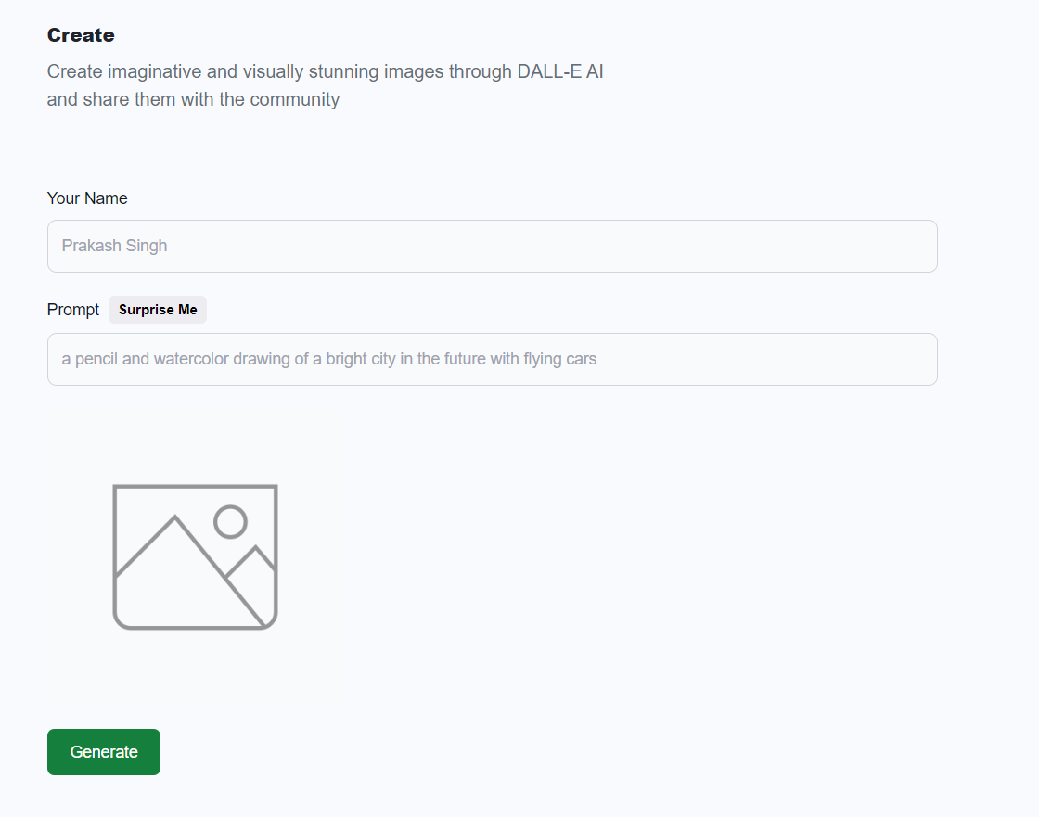
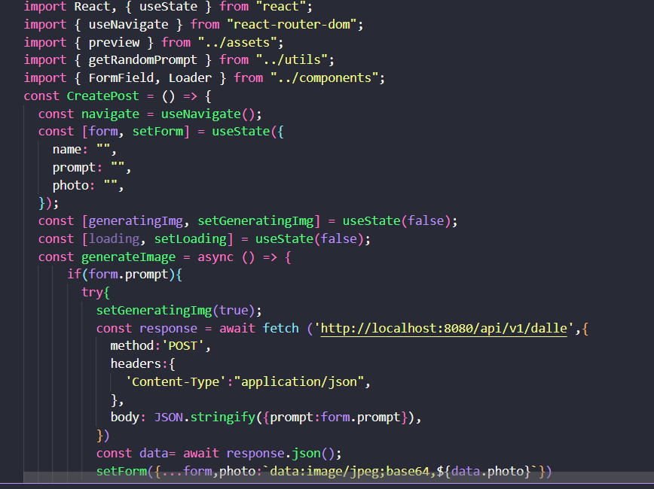
Post-Form

Slide 14
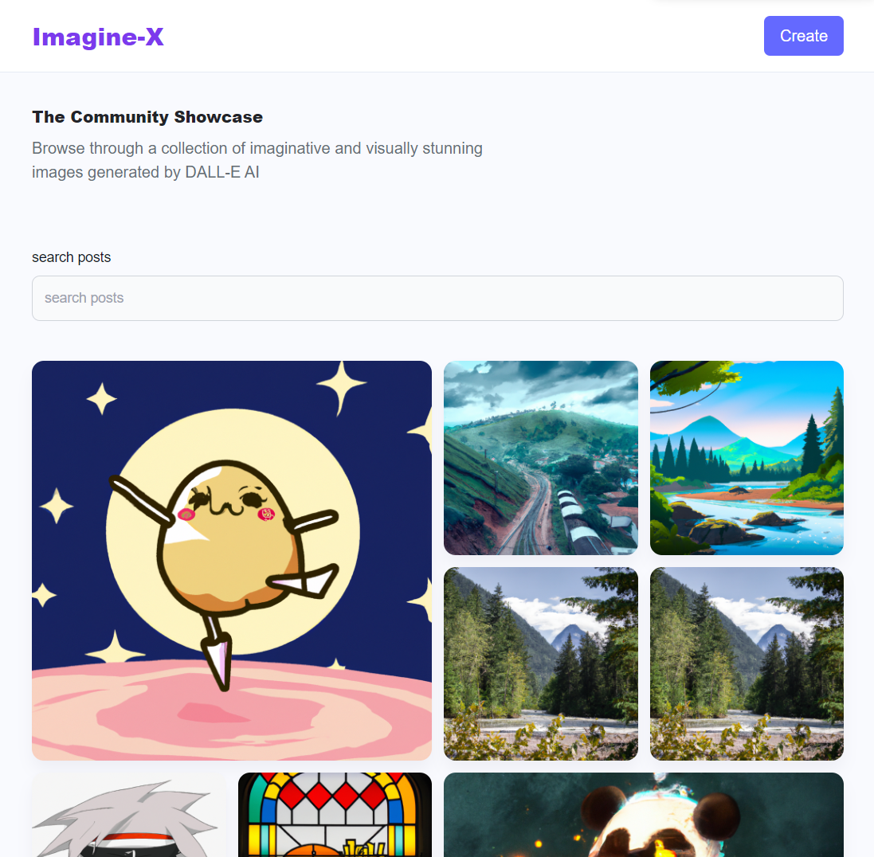
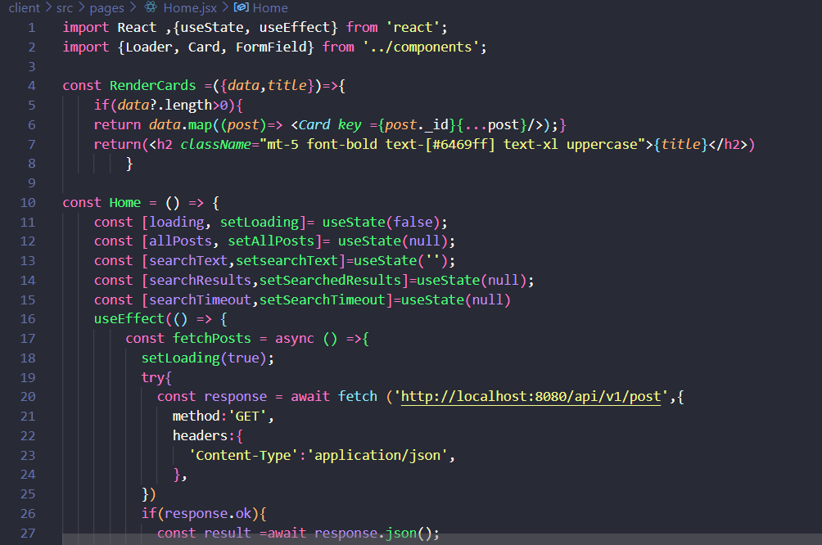
Home Page

Slide 15
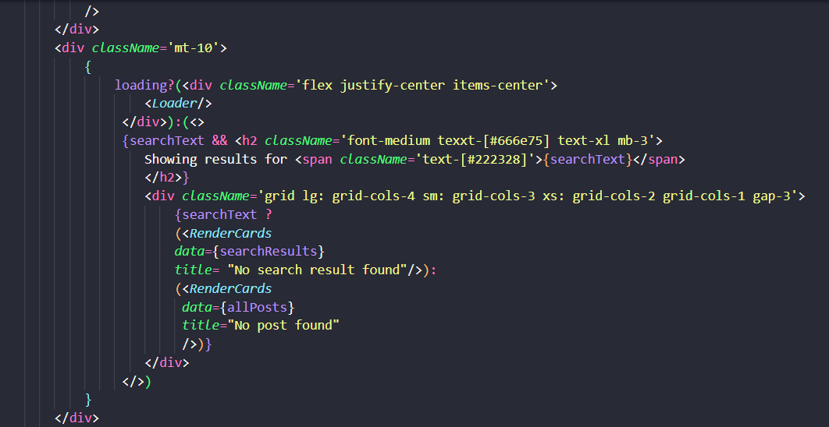
Search-Post

Slide 16
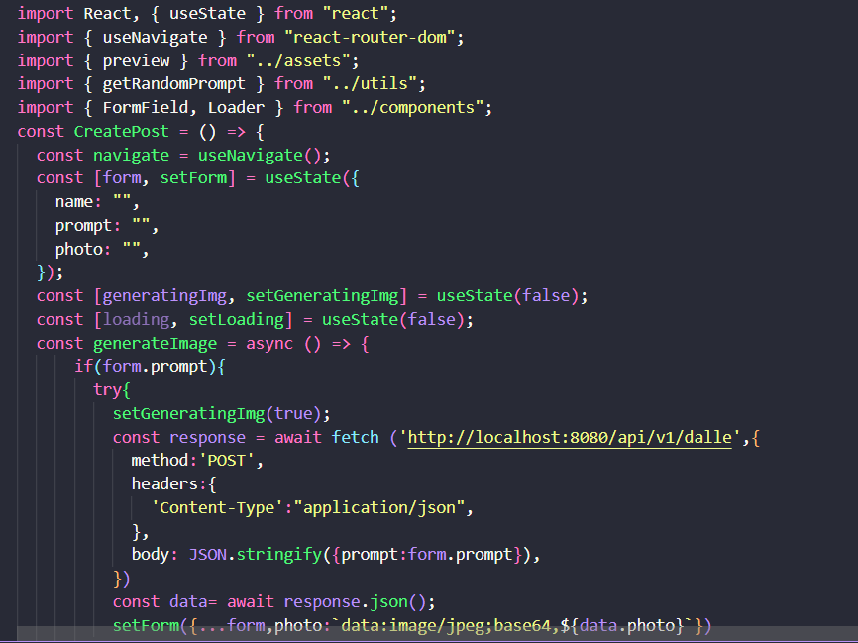
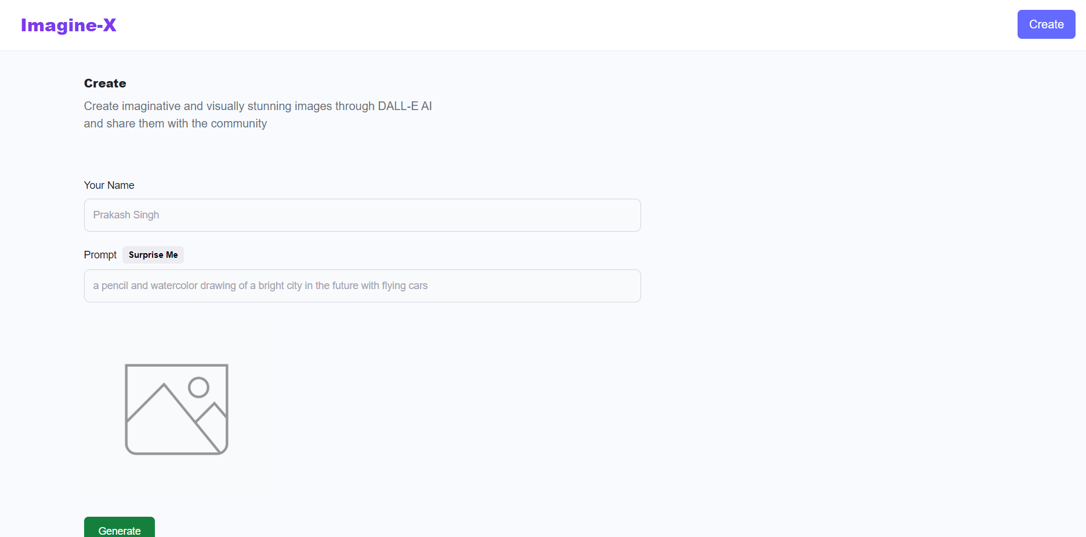
Create-Post Page

Slide 17
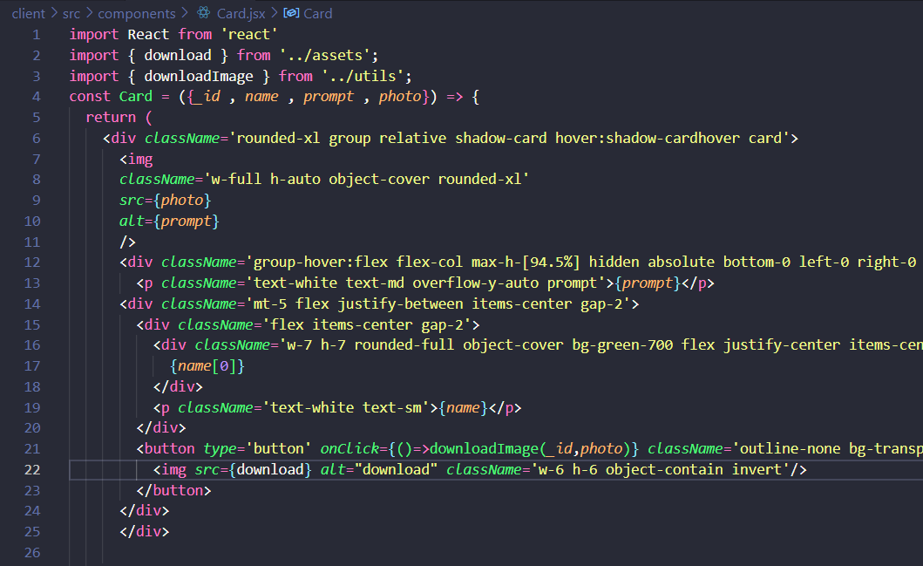

Card

Slide 18
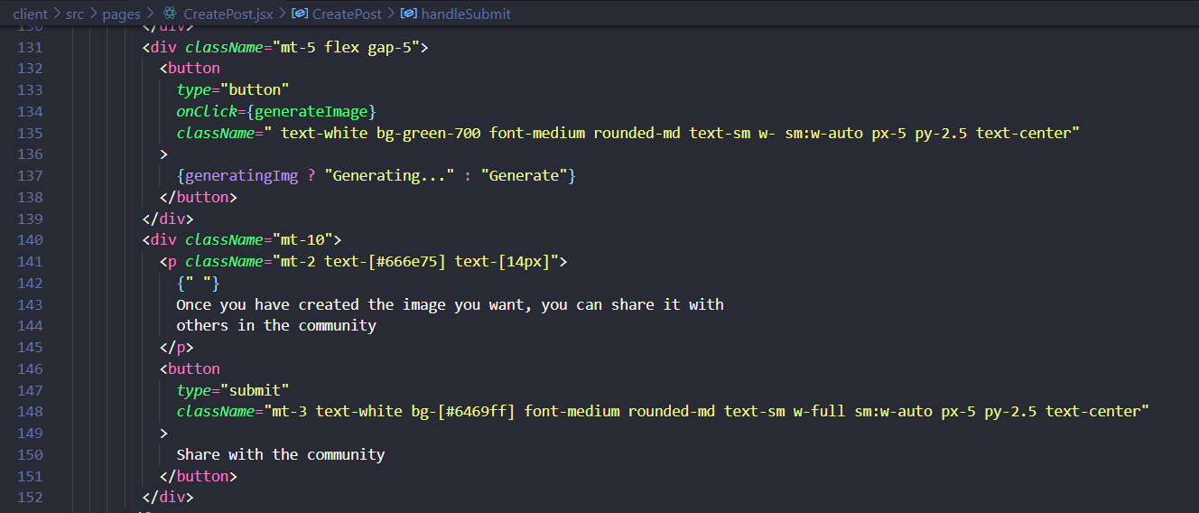

Share button

Slide 19
Future Scope
Image generation using artificial intelligence is a rapidly evolving field, and there are several avenues for future research and development. One promising area of future work is improving the quality and realism of generated images by exploring new GAN architectures and training techniques. Additionally, there is potential to combine image generation with other AI techniques, such as reinforcement learning and natural language processing, to enable more sophisticated and interactive applications. Another promising area of research is developing methods for controlling and manipulating generated images, allowing for more fine-grained control over the generated content. Finally, there is also a need to address the ethical considerations associated with the use of AI-generated images, such as issues of bias and privacy, and to develop frameworks for ensuring that these technologies are used in a responsible and equitable manner.

Slide 20
Conclusion
Image generation using Artificial Intelligence has seen significant progress in recent years due to the advancements in deep learning and neural networks. Various techniques such as Generative Adversarial Networks (GANs), Variational Autoencoders (VAEs), and Conditional GANs have been developed. Although the field has made significant strides, there are still challenges to overcome, such as generating high-resolution images, controlling the output of generated images, and ensuring fairness and inclusivity in the generated images. The future of image generation using Artificial Intelligence looks promising, with the potential to create personalized and realistic images for various applications.

Slide 21
References
[1] Goodfellow I. J., Pouget-Abadie J., Mirza M., Xu B., Warde-Farley D., Ozair S., Bengio Y. (2014). Generative adversarial networks. Proceedings of the 27th International Conference on Neural Information Processing Systems (NIPS), 2672-2680. DOI: 10.1145/3065386
[2] Kingma, D. P., & Welling, M. (2013). Auto-encoding variational Bayes. Proceedings of the 2nd International Conference on Learning Representations (ICLR). arXiv preprint arXiv:1312.6114.
[3] Karras, T., Laine, S., & Aila, T. (2019). A style-based generator architecture for generative adversarial networks. Proceedings of the IEEE Conference on Computer Vision and Pattern Recognition (CVPR), 4396-4405. DOI: 10.1109/CVPR.2019.00434.
[4] Isola, P., Zhu, J. Y., Zhou, T., & Efros, A. A. (2017). Image-to-image translation with conditional adversarial networks. Proceedings of the IEEE Conference on Computer Vision and Pattern Recognition (CVPR), 5967-5976. DOI: 10.1109/CVPR.2017.632

Slide 22
[5] Johnson, J., Alahi, A., & Fei-Fei, L. (2016). Perceptual losses for real-time style transfer and super-resolution. Proceedings of the European Conference on Computer Vision (ECCV), 694-711. DOI: 10.1145/3156541.3156566.
[6] Wang, T. C., Shi, B., Zhu, L., Liu, C., & Qi, Y. (2018). High-Resolution Image Synthesis and Semantic Manipulation With Conditional GANs. ACM Transactions on Graphics, 37(4), 1-14. DOI: 10.1145/3072959.3073590.
[7] Radford, A., Metz, L., & Chintala, S. (2016). Unsupervised representation learning with deep convolutional generative adversarial networks. In 4th International Conference on Learning Representations, ICLR 2016.

